Slide 1

05/01/2024
SALES STRATEGY
Pens & Printers

Slide 2
TABLE OF CONTENT
01.
Business Goals
02.
Findings & Key Metric
03.
Recommendations
04.
Conclusions

Slide 3

BUSINESS GOALS
Our ultimate goal is to quantify and improve customer engagement across all three sales strategies, resulting in a significant increase in company revenues as a whole efficiently.

Slide 4
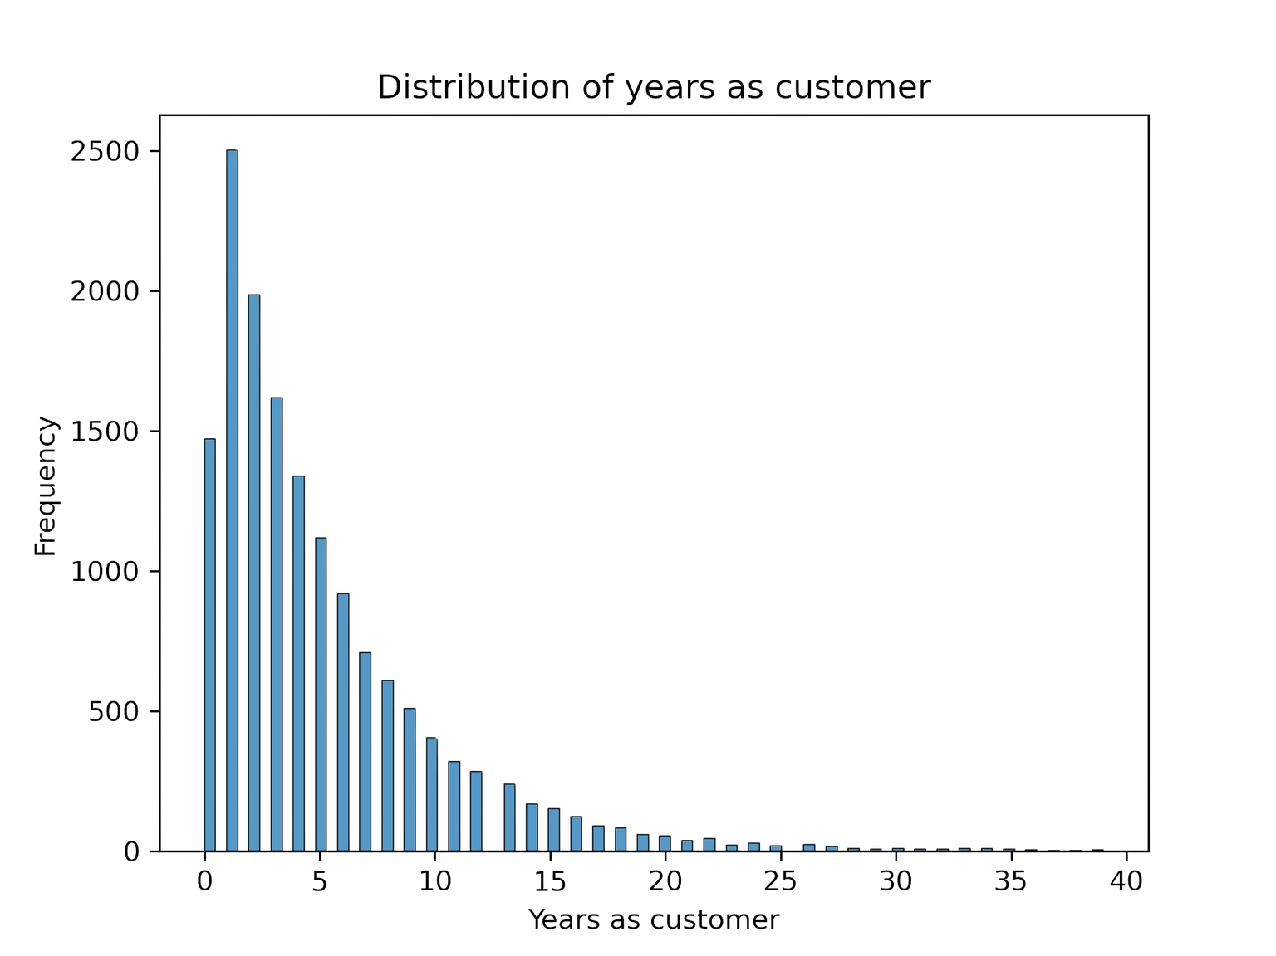
Findings

Slide 5
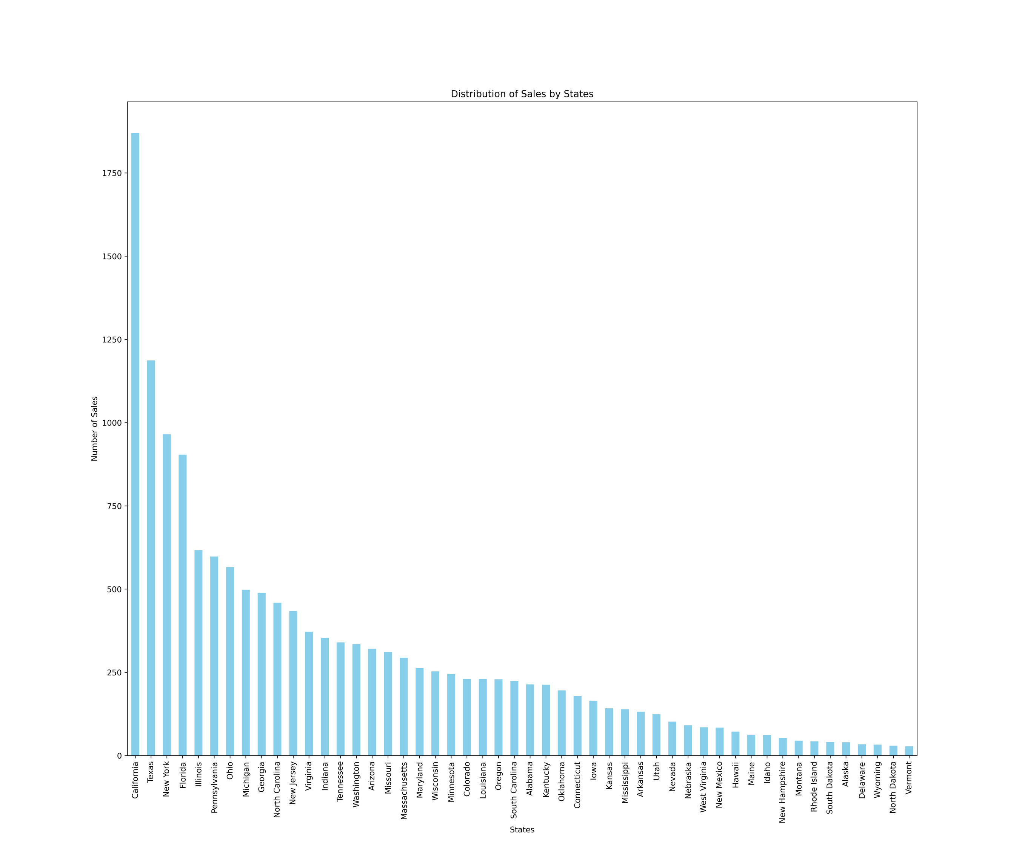
Geographical Analysis

Slide 6
Geographical Analysis
1870 times
28 times

Slide 7
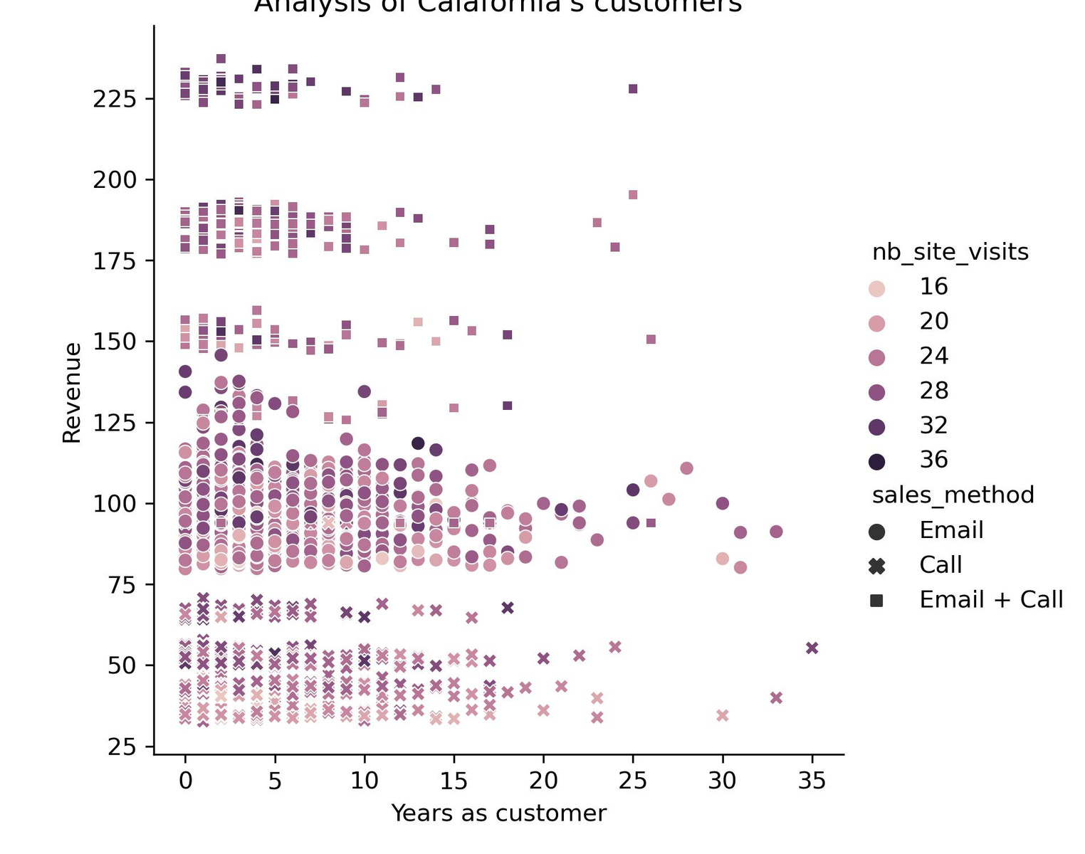
Customer Analysis in California

Slide 8
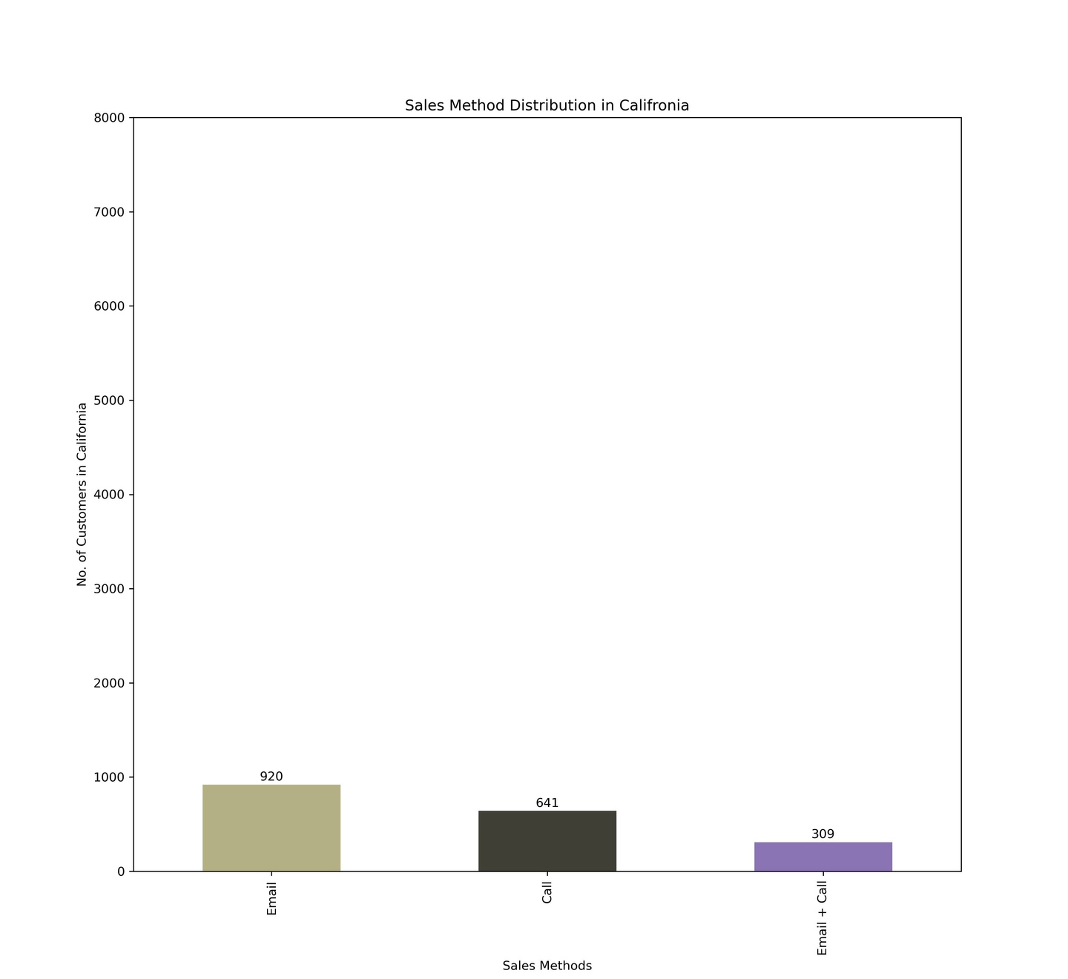
Sales Method Distribution (California)

Slide 9
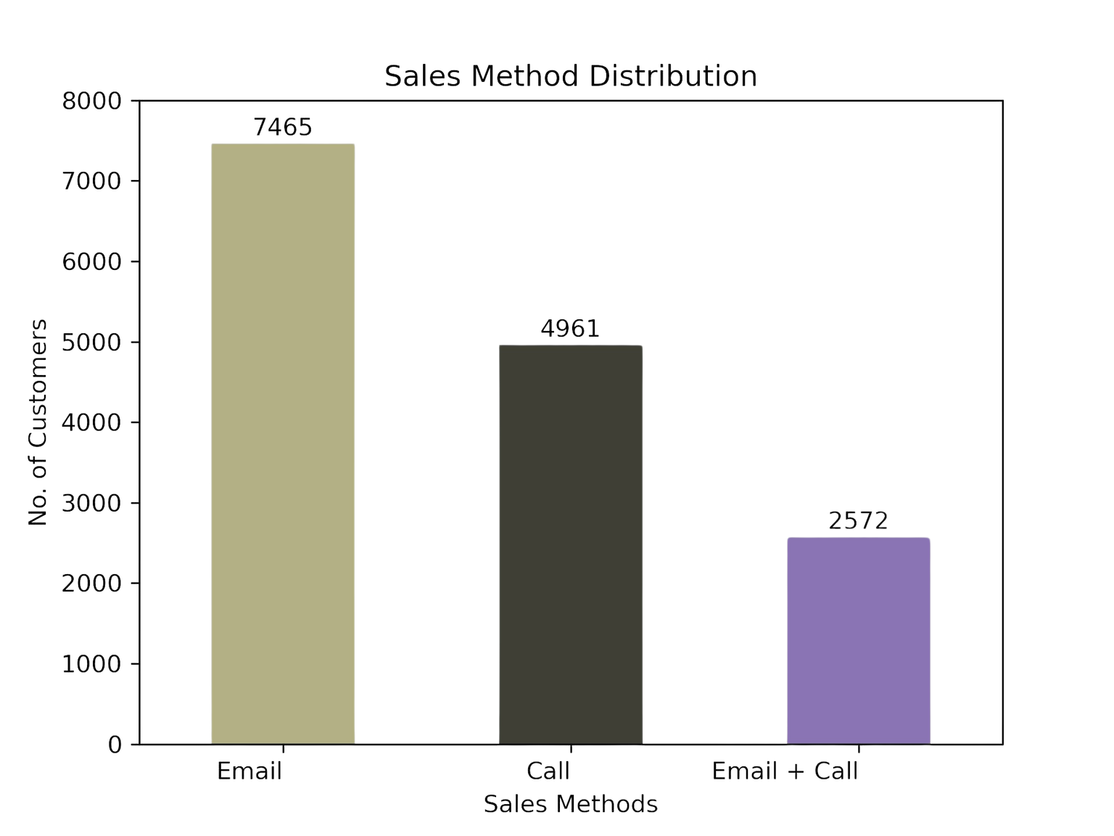
Sales Method Distribution (All States)

Slide 10
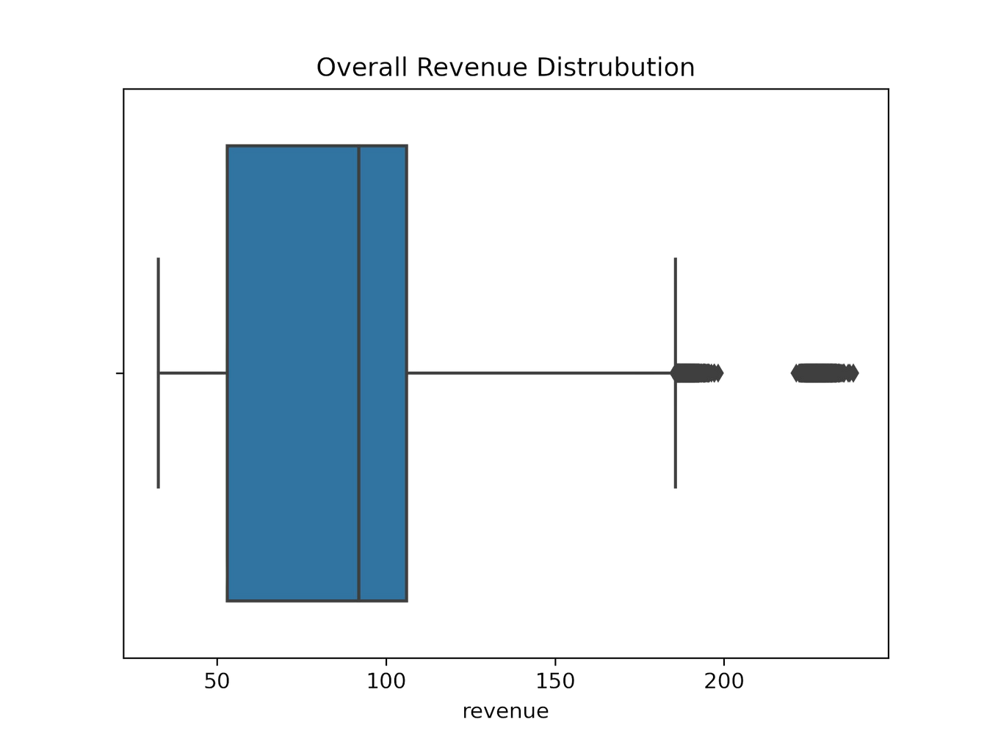
Spread of Overall Revenue

Slide 11
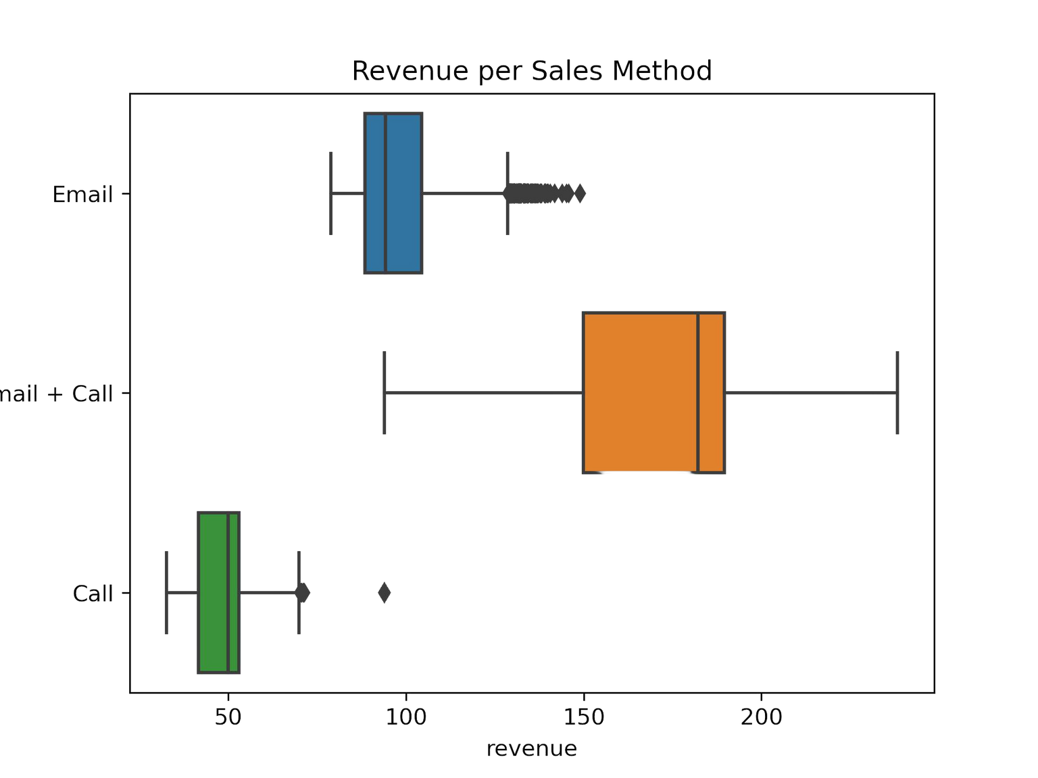
Spread of Revenue for Each Method

Slide 12
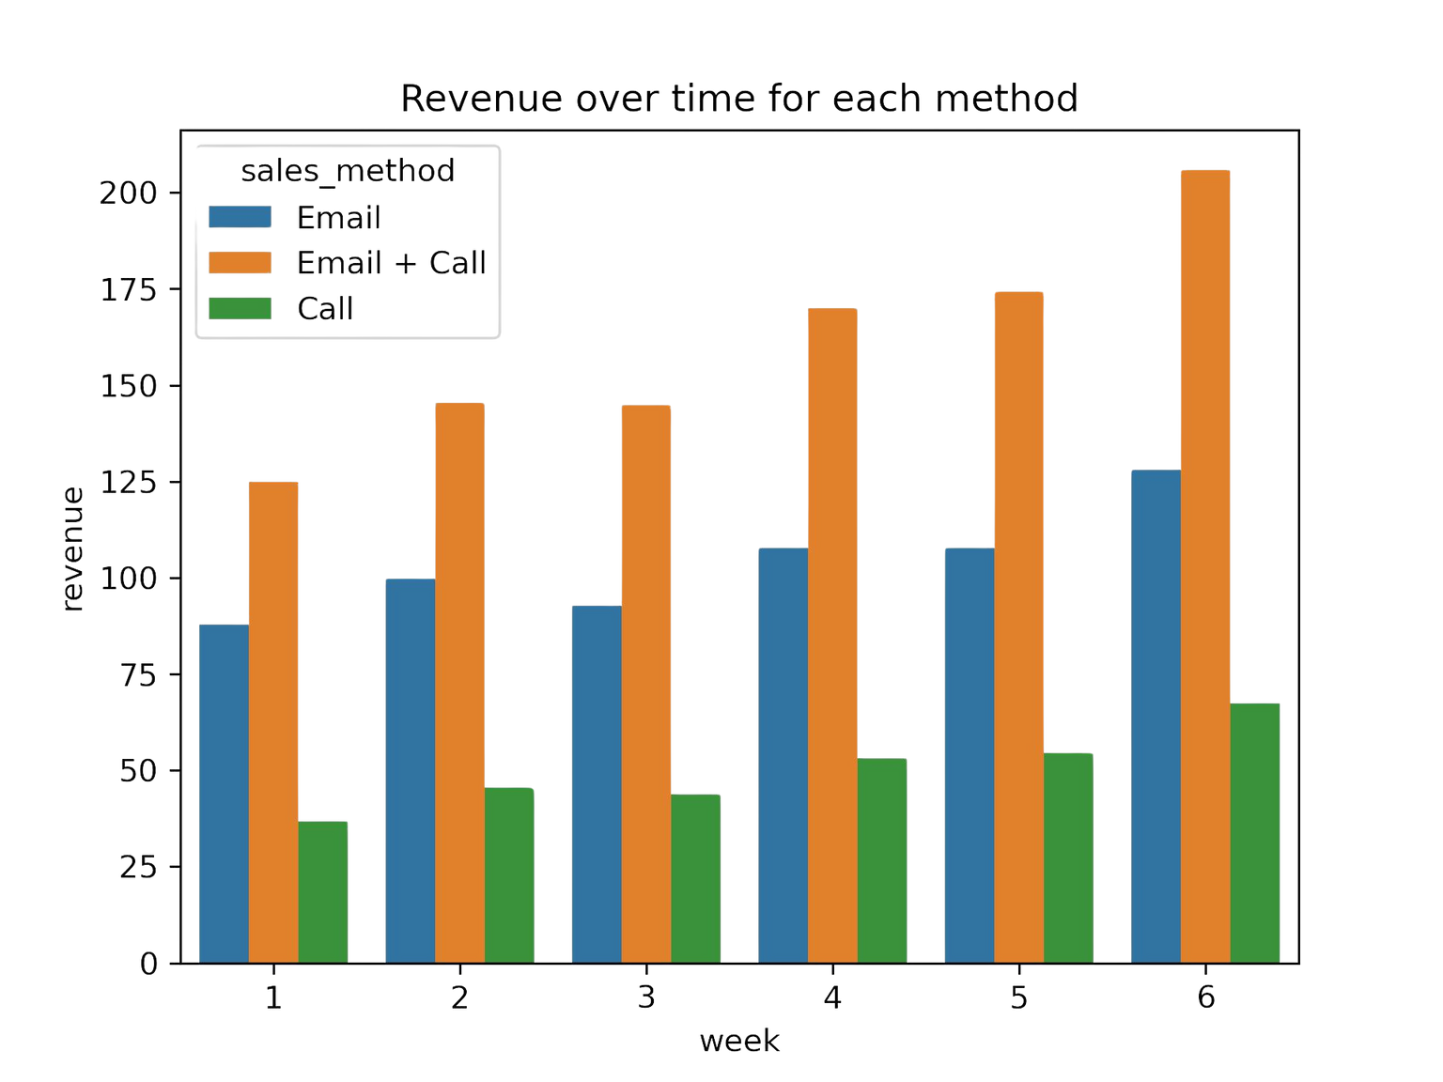
Revenue over time

Slide 13
Key Metrics
Average Revenue per User (ARPU)
The average revenue generated by customers in different approaches.
ARPU = Total Revenue / no. of customers in each approach
Initial estimates
Average Revenue per User (Email): 188.73
Average Revenue per User (Email + Call): 547.77

Slide 14

RECOMMENDATIONS
California ( A great market potential)
Vermont ( Identify Challenges )
Stick with the email or email and call approaches
Customer engagement has been declining over time.
The company should focus on the Customer Engagement Index (CEI).
Make sure these data are available when necessary, such as upcoming sales.
Beneficial to allocate resources, marketing efforts, and product development

Slide 15

Actions to take
Establish a regular monitoring plan to track the CEI, such as monthly or quarterly.
Design a dashboard that depicts the CEI and its separate components over time. (charts, graphs, heatmaps, etc.)
Put in place an alert system that alerts key stakeholders when the CEI undergoes substantial changes, allowing for timely inquiry and action.
Create CEI benchmarks based on historical data or industry norms. against evaluate performance, and compare current values against benchmarks.
Establish a feedback loop in which teams may share insights and feedback on issues impacting the CEI. This encourages ongoing strategy improvement and adaption.

Slide 16

Thank You
Contact:
kaungheinhtetutyccmm@gmail.com

